Slide 1
Advanced Car
Project Title:

Slide 2
Team Members:
Md. Al-amin - 2021200000088
Md. Raihan Shikder - 2021200000089
Md. Shahrear Mostofa - 2021200000060

Slide 3
Concepts
Purposes of the project
Features of the project
Future of the project
Three main parts of the project

Slide 4
Purposes of the Project

Slide 5
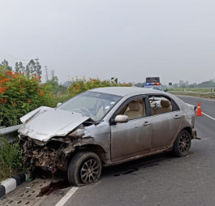
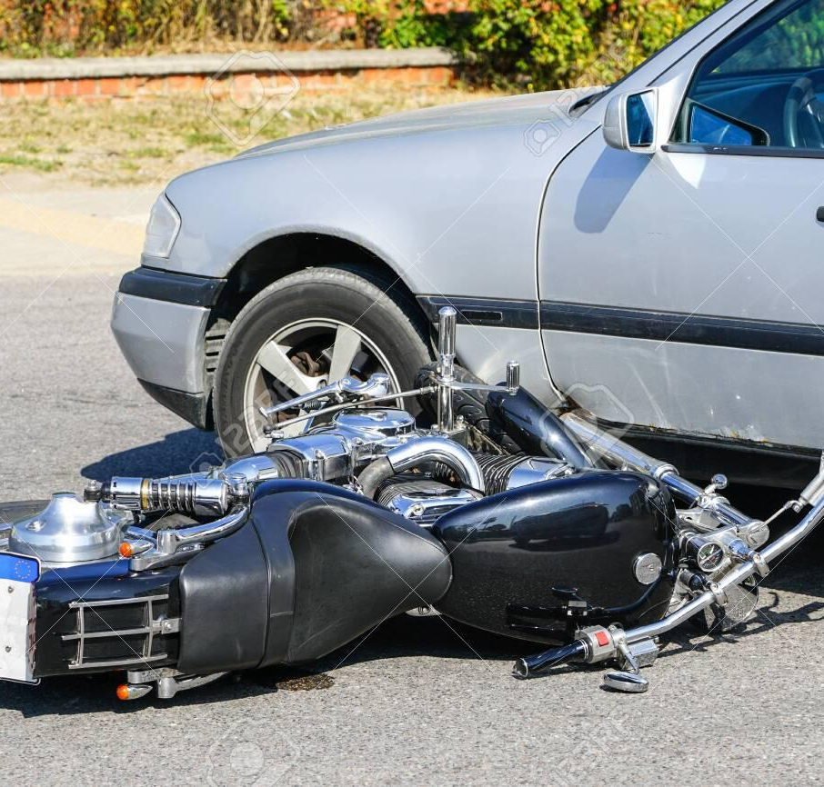

Road Accident Scenario:
In 2021, there were 5,629 accidents led to 7,809 deaths.
In 2022, there were staggering with at least 6,749 left 9,951 people dead.

Slide 6
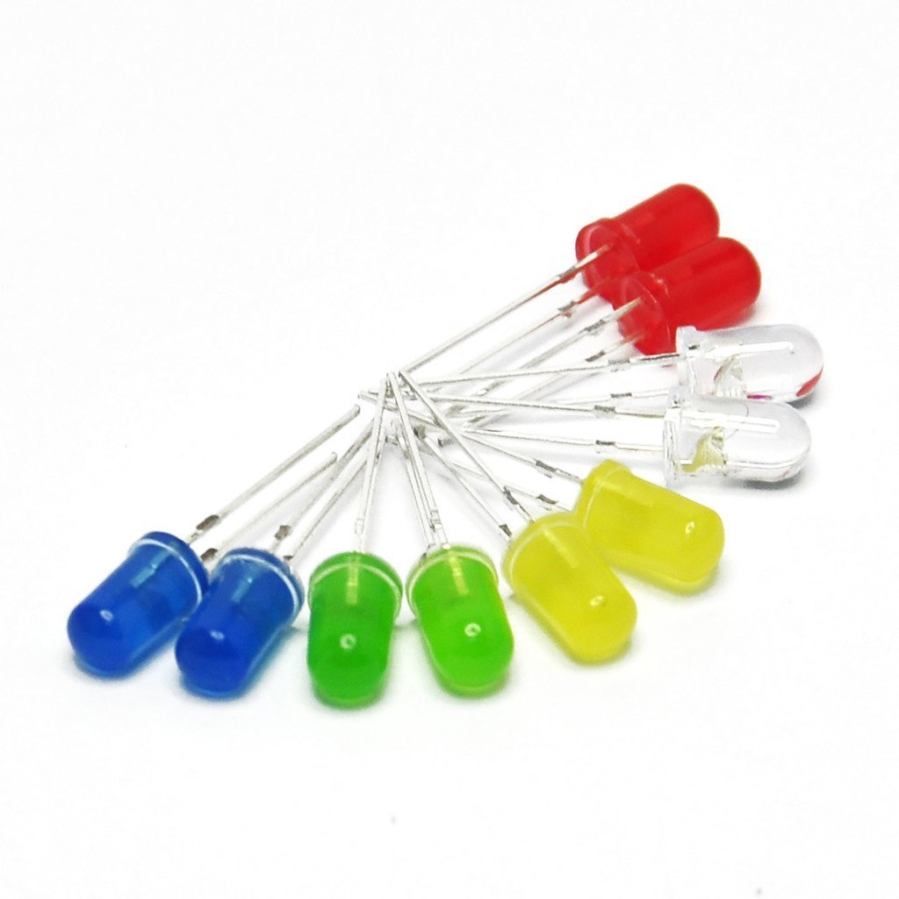
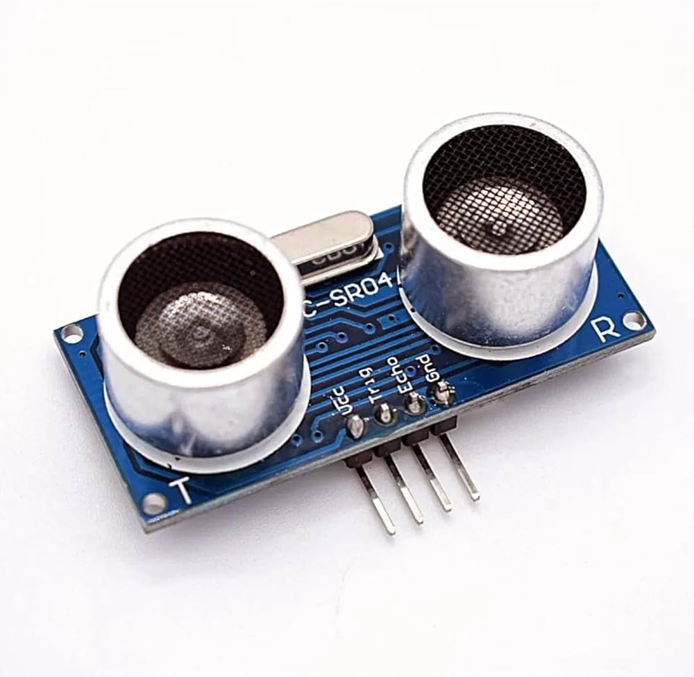
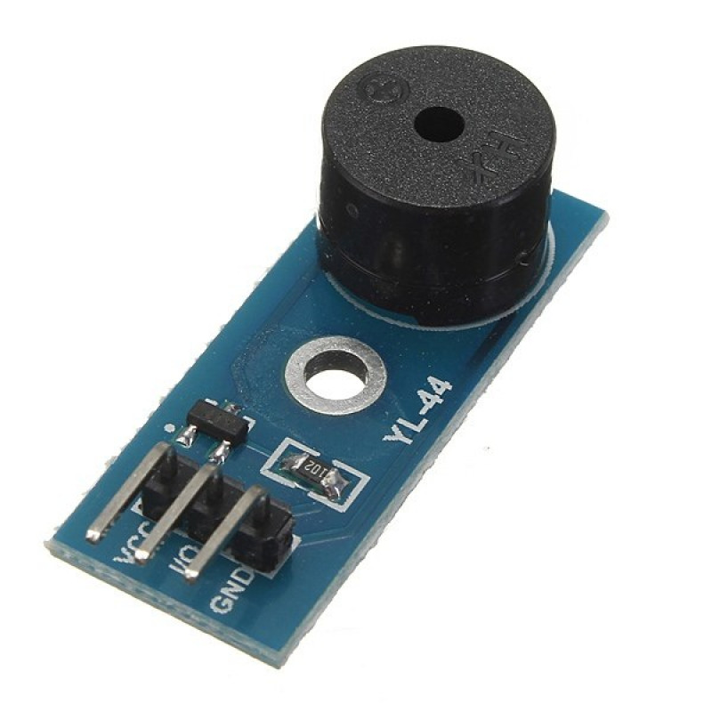
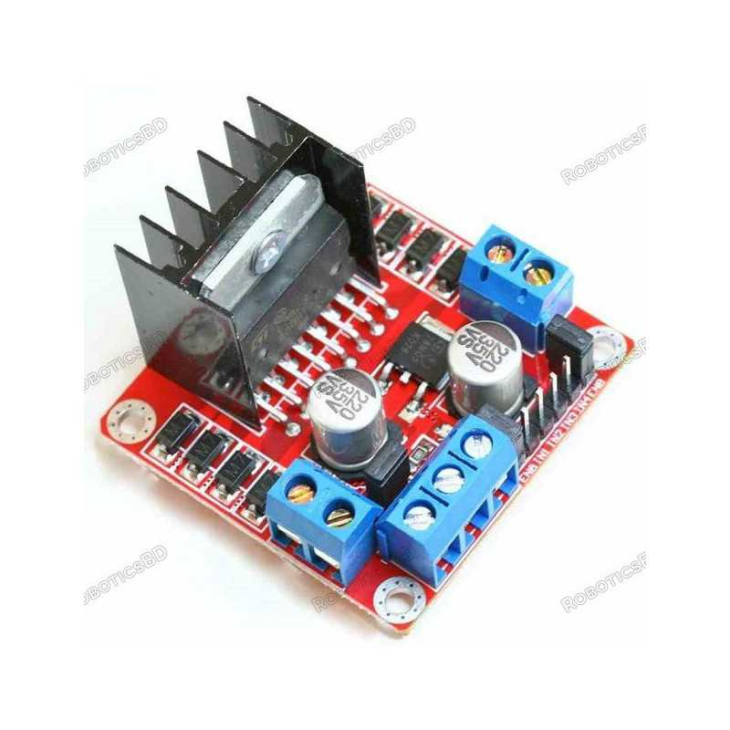
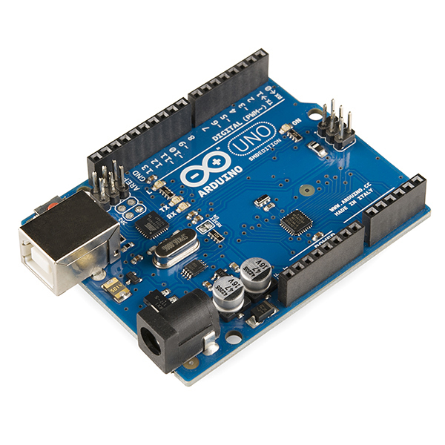
Hardware Components
Ultrasonic sensor
LED Indicator
Buzzer
L298N motor Driver
Arduino Uno

Slide 7
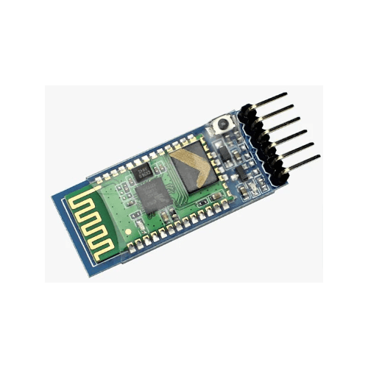
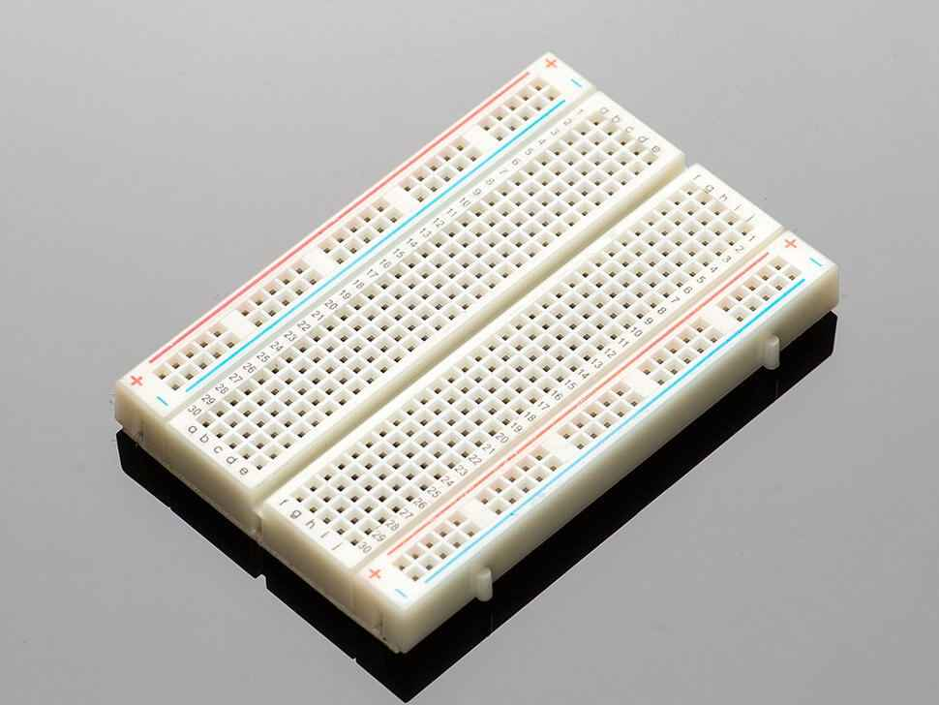
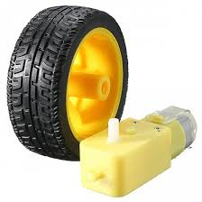
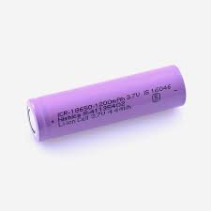
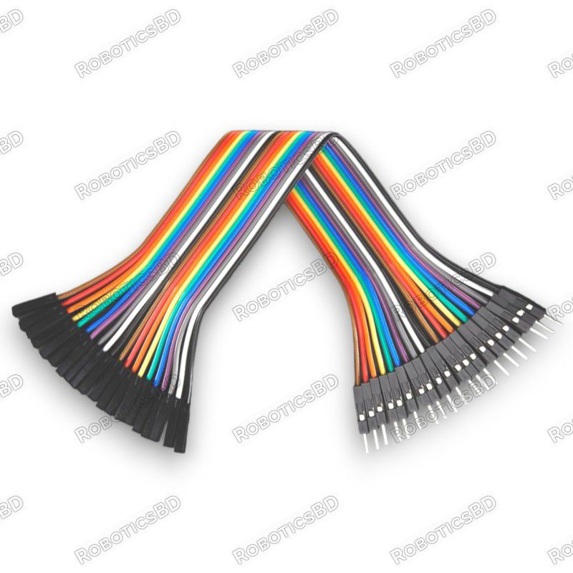
Hardware Components
Bluetooth Module
Breadboard
Motors and Wheels
Battery
Wires

Slide 8
Features of the Project

Slide 9
Features
Obstacle detection
Automated Brake/Go Backward for save Distance.
LED Indicator
Bluetooth Control with Mobile

Slide 10
L298N is a dual H-bridge motor driver that allows control of the direction and speed of two DC motors by using PWM signals. It operates by switching the current flow through the motors, enabling forward, reverse, and braking actions.
L298N motor Driver

Slide 11
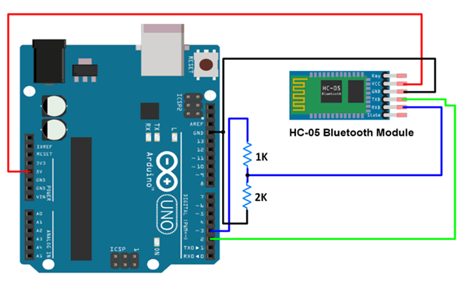
Bluetooth Mobile Controller
Bluetooth module enables wireless communication between devices by transmitting data over short distances using radio waves. It pairs with other Bluetooth-enabled devices, allowing them to exchange information and commands seamlessly.

Slide 12
Buzzer
Arduino Uno
Arduino Uno is an open-source microcontroller board based on the ATmega328, designed for easy programming and prototyping. It reads inputs from sensors and controls outputs like motors and LEDs, allowing users to create interactive electronic projects.
Buzzer produces sound when an electrical current passes through it, causing a diaphragm to vibrate and create audible sound waves.

Slide 13
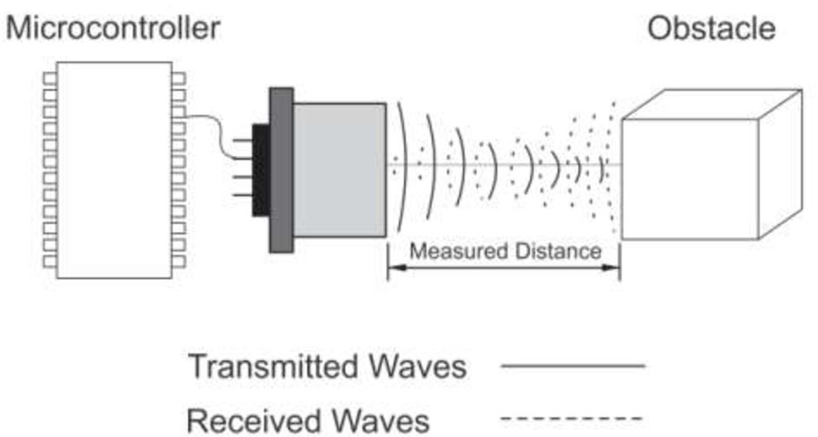
LED Indicator
Obstacle Detection
Ultrasonic sensor produce sound waves and measures the time it takes for the echoes to return after bouncing off an object. This time delay is used to calculate the distance to the object based on the speed of sound.
LED light HIGH when an electric current passes through a semiconductor, causing it to release energy in the form of photons.

Slide 14
Future of the Project

Slide 15
Future of this system
In today’s Bangladesh, accident case is very heard news. Daily many accident case came to us about speeding or overtaking and lake of braking system of vehicles. By using this system accidents can be prevent and people will be safe during driving. In future we can prosper in transportation system. Our system is not so expensive but very useful to everyone.

Slide 16
Thank You!

